Slide 1
Entertainment Education and Digital Media
Caroline Jacoby, Jane Brown and
Caitlin Loehr
Tuesday, December 13, 2016

Slide 2
Entertainment: holds the attention of the audience, engages emotion and stimulates senses
Education: encourages and enables a person to develop and grow; enriches, enhances our knowledge and our life
Notes:
EE is not a theory it is a strategy
As the class to discuss the difference between Entertainment and Entertainment-education
What’s the proper balance? 70-30? 80-20?

Slide 3
Digital Media and EE
Stories/testimonials
Drama
Games
Music/Art/Folk media
Sports
Transmedia (using same characters across multiple platforms)
Notes:
EE is not a theory it is a strategy
As the class to discuss the difference between Entertainment and Entertainment-education
What’s the proper balance? 70-30? 80-20?

Slide 4
Examples

Slide 5
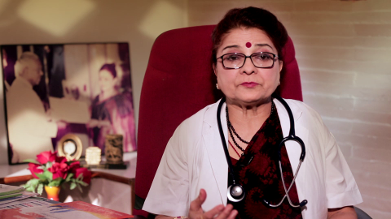
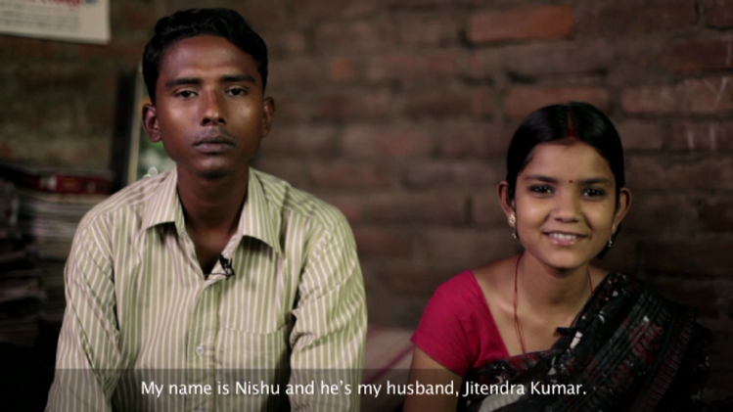
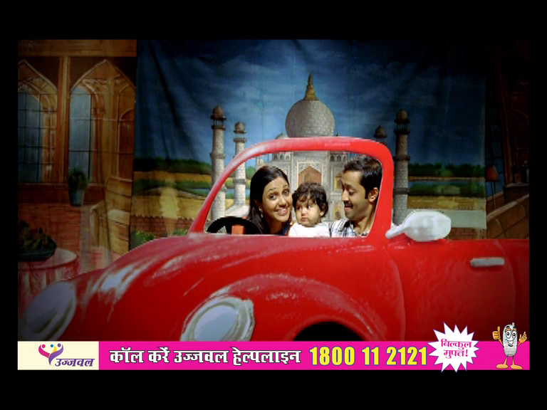
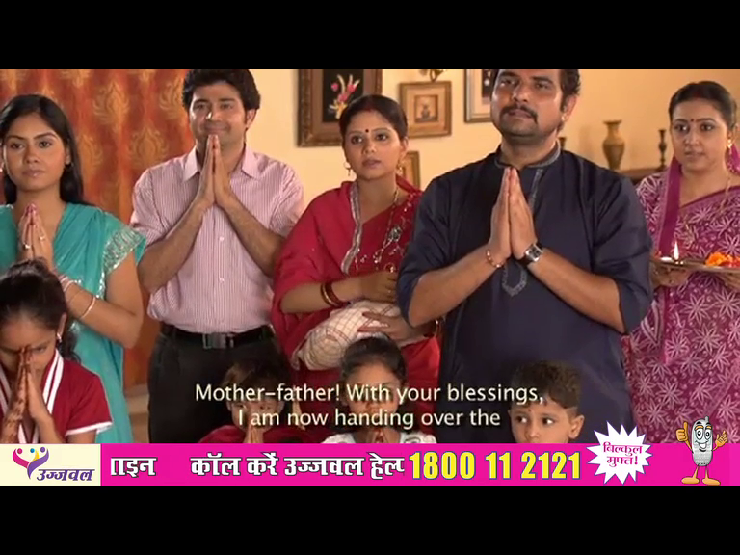
Gyan Jyoti 360˚ communication materials for family planning on mobile
Doctor Film
Role Model Film
TV Spot
Soap opera based Film

Slide 6
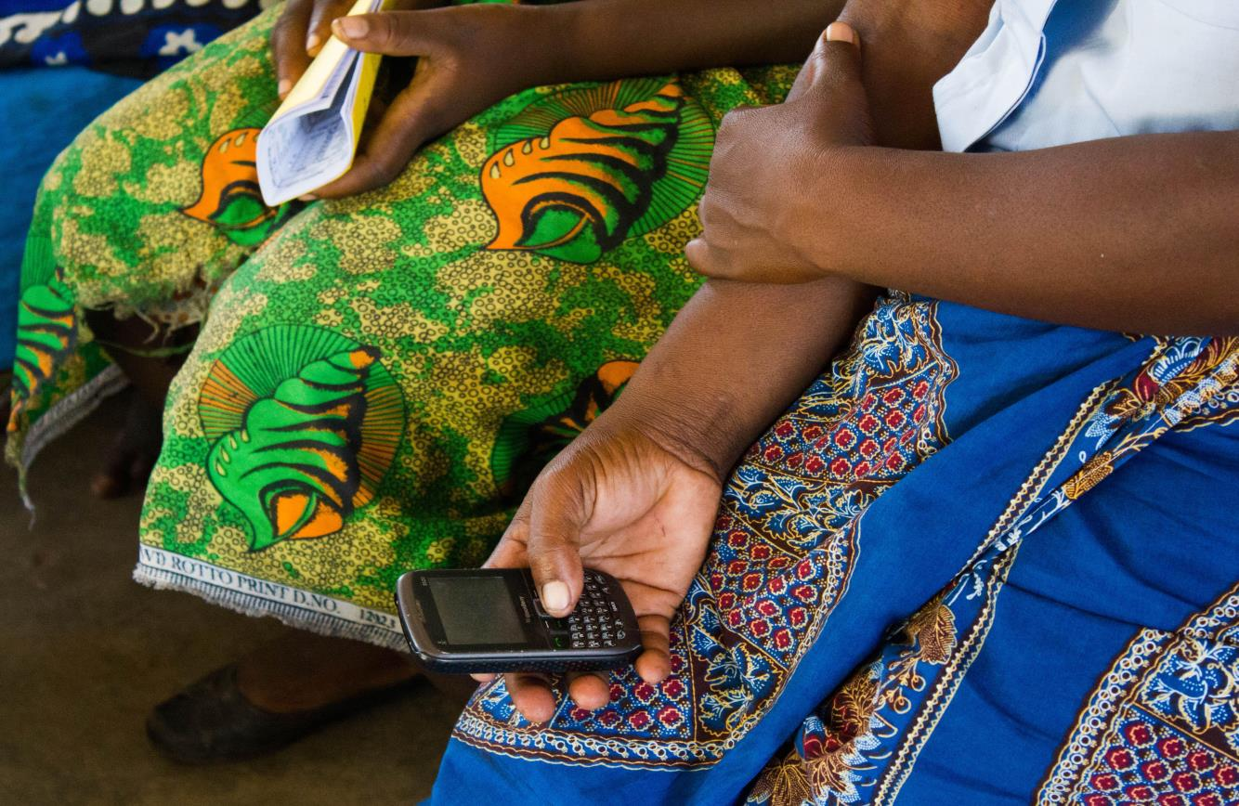
Smart Client – EE via IVR
© Jodi-Ann Burey/VillageReach, Courtesy of Photoshare
Notes:
IVR has been used to get audio content directly to individuals, typically the information delivered is short and simple, such as reminders, tips or announcements. The Smart Client tool has been developed to explore the possibility of using IVR to deliver content that is entertaining and informational. Users register for the tool and receive a series of 17 calls, which contains multiple segments that callers can choose to listen to – including a drama, a sample dialogue, a testimonial, quiz questions and dialogue with friendly host characters. Using IVR to deliver this content gives users a more interactive experience and through built-in analytics, the program can track listening patterns and responses to quiz questions in real time.

Slide 7
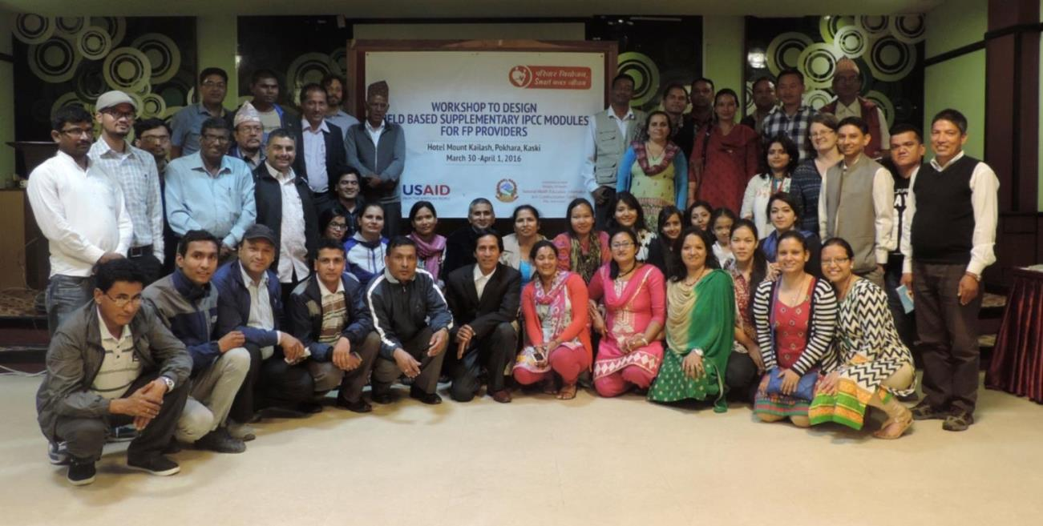
Scenario-based Counseling Skills App for Providers in Nepal

Slide 8
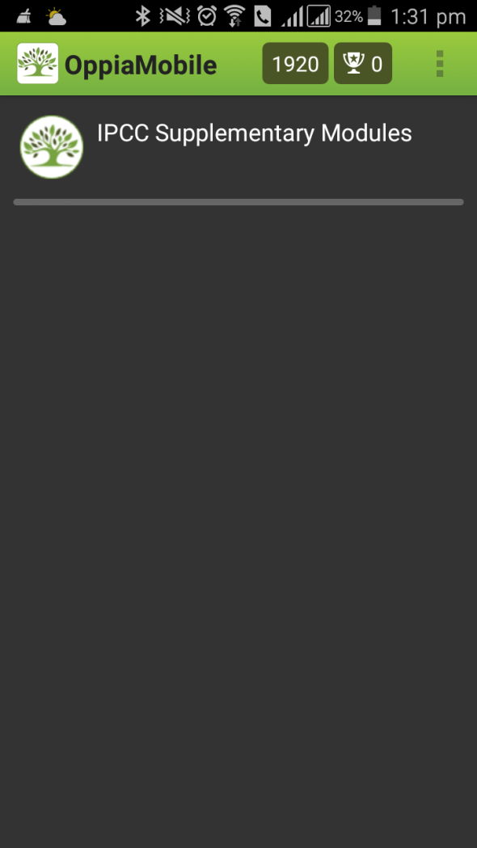



Slide 9
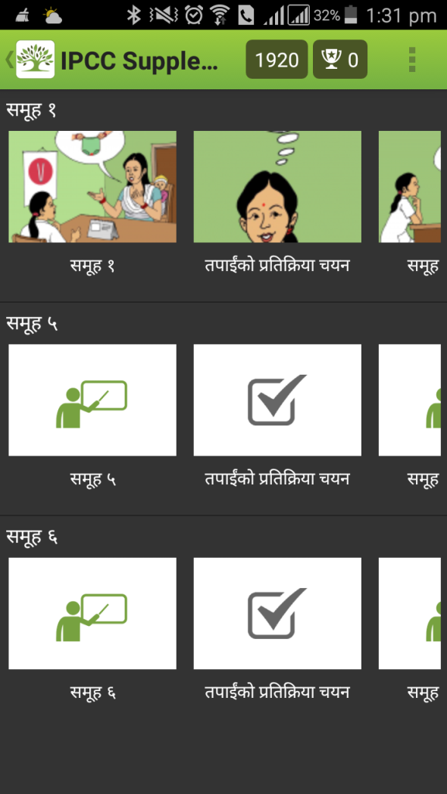

Slide 10
Postpartum Family Planning Scenario up to decision point
Providers are supposed to offer family planning within 45 days of delivery, but many don’t due to lack of knowledge about when a woman can get pregnant.
Link to the video part one here

Slide 11
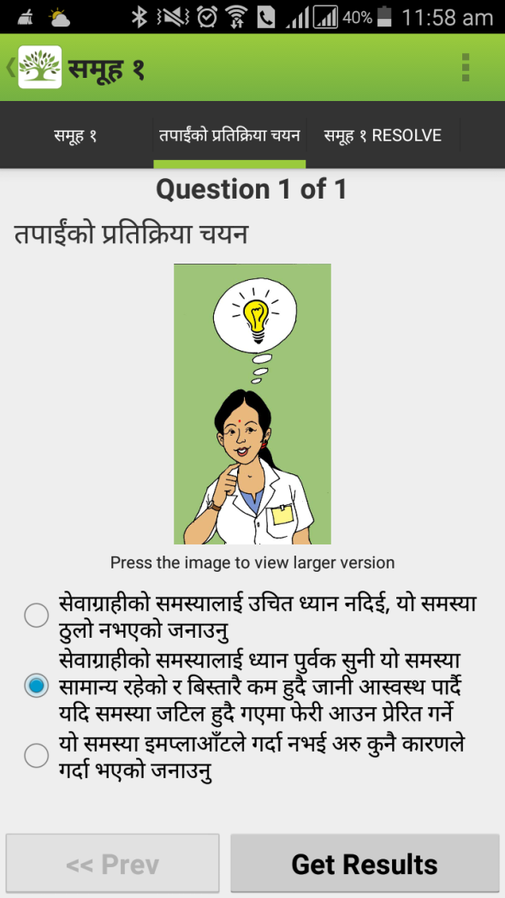
It can happen but you don’t need to worry about it if you are breastfeeding up to six months. We can talk then.
If your menstruation returns, then it could happen, but you don’t need to worry about this now. Come back when your period returns.
Yes, a woman can get pregnant after 45 days before her menstruation if she is not breastfeeding exclusively.

Slide 12
Scenario Resolve
After picking right answer only, scenario continues or resolves until the next decision point.

Slide 13
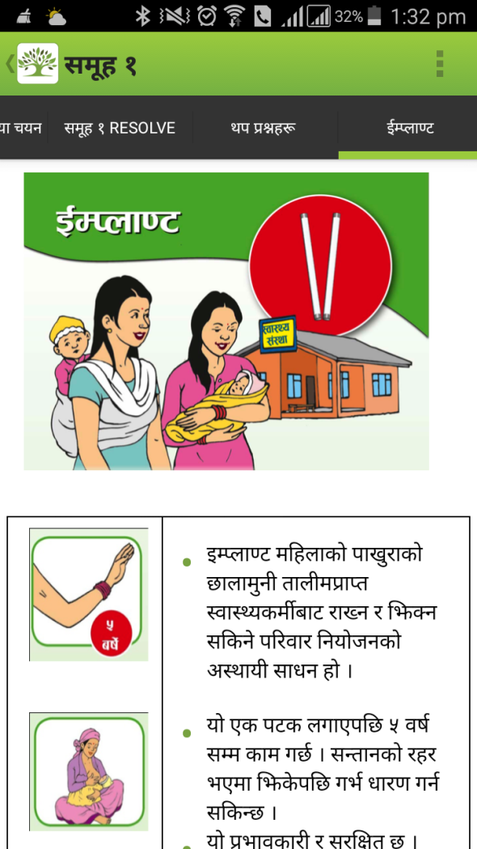

Slide 14
Scenario development audience, sample and instructions

Slide 15

Audience Profile
Health workers – male or female, who provide FP services to clients. Overworked, low paid, hard working, doing the best with what they know and have experienced.
Motivated to help clients.

Slide 16
Sample scenario
Scenario
Newly married Shyam (23) and Jeena (21) couple wants to delay first child using pills. They want to go to college for three years.
Provider Barrier:
Provider bias against delaying first birth and using a hormone method to delay first birth.

Slide 17
What should the Provider do?
She recommends that the couple should have a first child before using family planning.
She asks questions confirming intentions, and provides counseling on the chosen method.
She tells the clients to use condoms because if you use a hormone method before you have your first child, you could become infertile.

Slide 18
Scenario Resolve
Correct answer: B
She will explain key information about the pills and how to use it. She will say that there are also other methods and asks if she wants to hear about them
She will explain about side effects and what to do.
She will invite her to come back if there is a problem.
The clients and the provider are happy.

Slide 19
Instructions for Group Work
Select a Scenario with Provider Bias
Script opening scene up to ‘key decision making point’
Write three answers to ‘what should the provider say?’ All feasible but one is right.
Write resolve – what happens if the provider makes the correct choice
Film at least opening scenario and questions (resolve also, if time permits) with phone and give to facilitators

Slide 20
Scenario One :
A woman with two children and has never used a family planning method asks the provider to choose the best method for her.
  Provider Barrier: Providers choose for the client rather than facilitate choice
Scenario Two:
A couple comes in to talk about a side effect of bleeding when starting use of the Depo Injection. The husband is doing all of the talking.
  Provider Barrier: Providers talking to the man in a couple only rather than both.
Scenario Three:
An unmarried woman comes into the clinic asking for pills.
  Provider Barrier: Bias against providing counseling/ services for unmarried youth.

